Slide 1

“Grocery Website”
Front end Module

Slide 2
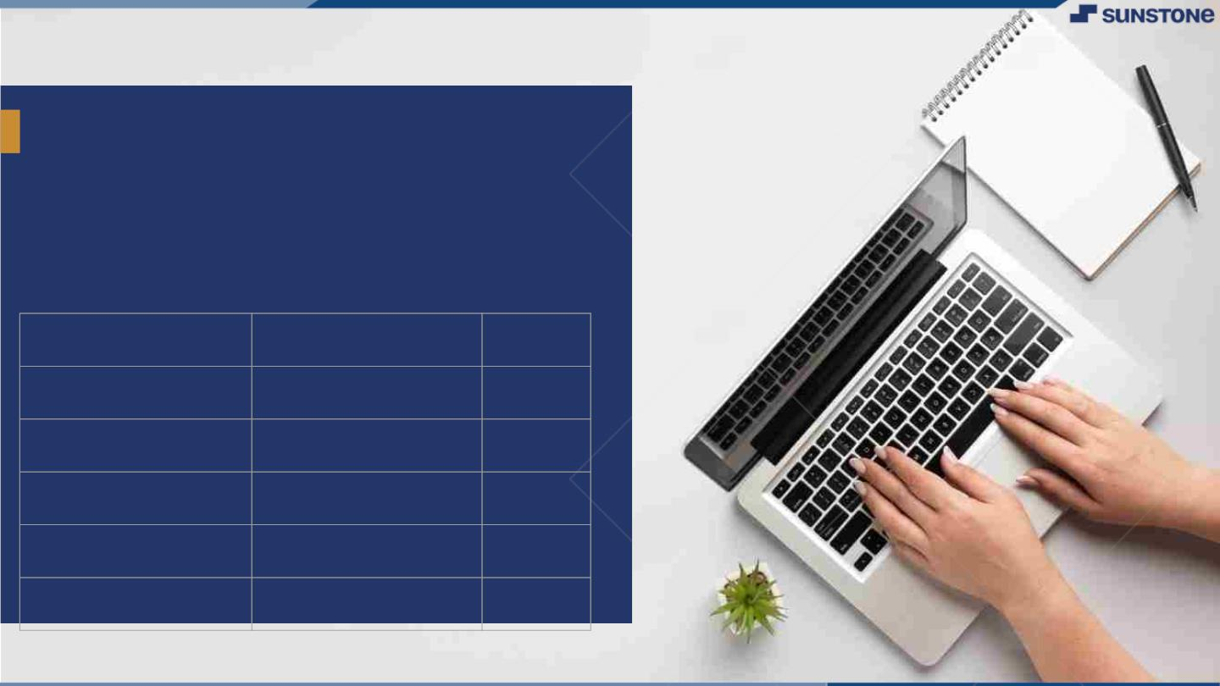
INTRODUCTION
An introduction to a grocery website should effectively convey the purpose, value, and unique selling points of the online platform.
The system decrease a much of work load for customer.
They can easily buy the grocery products from home through internet.
LMS Username
Name
Batch
au421320104027
PUGALENTHI. S
10
au421320104029
RABBANI MOHYADEEN.M
10
au421320104027
SASIKUMAR .R
10
au421320104048
THIYAGARAJAN .A
10
au421320104027
RATHISH .J
10

Slide 3

UI Components
Navigation Bar: The navigation bar typically includes links to key sections of the website, such as Home, Shop, Categories, Specials, My Account, Cart, and Checkout. It helps users easily access different parts of the site.
Search Bar: A search bar allows users to quickly find specific products by entering keywords or item names. Auto-suggestions and filters can enhance the search experience.
Shopping Cart: The shopping cart displays a summary of the items selected for purchase. Users can view, modify quantities, and remove items from the cart. It also shows the total order amount.
Product Details Page: When a user clicks on a product, they are taken to a dedicated page that provides more information, including a larger image, detailed description, customer reviews, nutritional information, and the option to add the item to the cart.
Integrate the API to the frontend to ensure dynamic feature
Product Catalog:
Product Details:
Shopping Cart:
Delivery and Pickup Options:
Order Tracking:
Secure Payment Processing:
Customer Support:
Product Availability and Stock Updates:
Reviews and Ratings:

Slide 4

Learning Outcomes
Grocery shopping can vary widely from person to person, depending on their individual goals, preferences, and circumstances.
Grocery shopping can have various outcomes, which depend on factors such as your choices, goals, and the shopping experience
Convenience:
Grocery shopping can provide convenience, as you can stock up on essential items and have them readily available for your daily needs.
Cost Savings:
Smart grocery shopping can lead to cost savings by reducing the frequency of dining out or ordering takeout.
Variety:
Grocery shopping enables you to explore a wide variety of food options and ingredients to diversify your diet and try new recipes.
Special Occasions:
Grocery shopping for special occasions, holidays, or gatherings allows you to purchase specific items and ingredients needed for those events.
Time Management:
Efficient shopping can save time by reducing the frequency of trips to the store and planning meals ahead of time.

Slide 5
Step Wise Description
Grocery shopping involves several steps to ensure a successful and efficient experience. Here's a step-by-step description of the grocery shopping process:
Preparation:
Make a shopping list: Before heading to the store, create a list of items you need to purchase. Organize it by categories like produce, dairy, meat, canned goods, and non-food items.
Budgeting:
Determine your budget: Set a budget for your shopping trip to help you manage your expenses and make informed decisions while shopping.
Shopping in the Store:
Arrive at the store: Once at the store, grab a shopping cart or basket if needed.
Follow your list: Start shopping according to your list, moving from one category to another, and selecting items you need.
Payment:
Payment Method: Pay for your groceries using your preferred payment method, such as cash, credit/debit card, mobile payment, or electronic transfer.
Transportation:
Transportation Charges: Load your groceries into your vehicle or onto public transportation, ensuring proper handling of perishable items.
Review Receipt:
Receipt: Review your receipt to confirm that all items were accurately scanned and that any discounts or coupons were applied correctly.

Slide 6
Summary of our Task
The task of grocery shopping involves a series of steps aimed at acquiring essential food and household items from a grocery store. Here is a summary of the key tasks involved in grocery shopping:
Preparation:
Create a shopping list that outlines the items you need and consider your budget.
Store Selection:
Choose a grocery store that suits your preferences in terms of location, product variety, and pricing.
Supplies:
Bring reusable bags and your prepared shopping list to the store.
Shopping in the Store:
Navigate through the store, following your list and selecting items from different categories.
Product Selection:
Evaluate product quality, compare prices and brands, and check expiration dates for perishable items.
Efficient Shopping:
Avoid impulsive purchases and be open to alternative choices if certain items are unavailable.
Checkout:
Proceed to the checkout counter and place your items for scanning by the cashier.
Payment:
Pay for your groceries using your preferred payment method, whether it's cash, card, or digital payment.
Packing:
Bag your groceries or arrange them in bags by category for ease of unpacking at home.
Transportation:
Safely transport your groceries back to your home, ensuring the proper handling of perishable items.
Unpacking at Home:
Organize and store groceries, placing perishables in the refrigerator or freezer and non-perishables in the pantry.

Slide 7
Receipt Review:
Examine your receipt to verify the accuracy of scanned items and applied discounts.
Reflect and Plan:
Reflect on your shopping experience, identify areas for improvement, and plan for future shopping trips.
The goal of grocery shopping is to procure the necessary items to meet your household's needs and preferences, manage your budget effectively, and ensure that perishable items remain fresh and safe for consumption
Technologies and Resource used
Frontend : HTML, CSS and Javascript
Backend : SQL and NodeJs
Styling : CSS
Languages : HTML and JavaScript

Slide 8
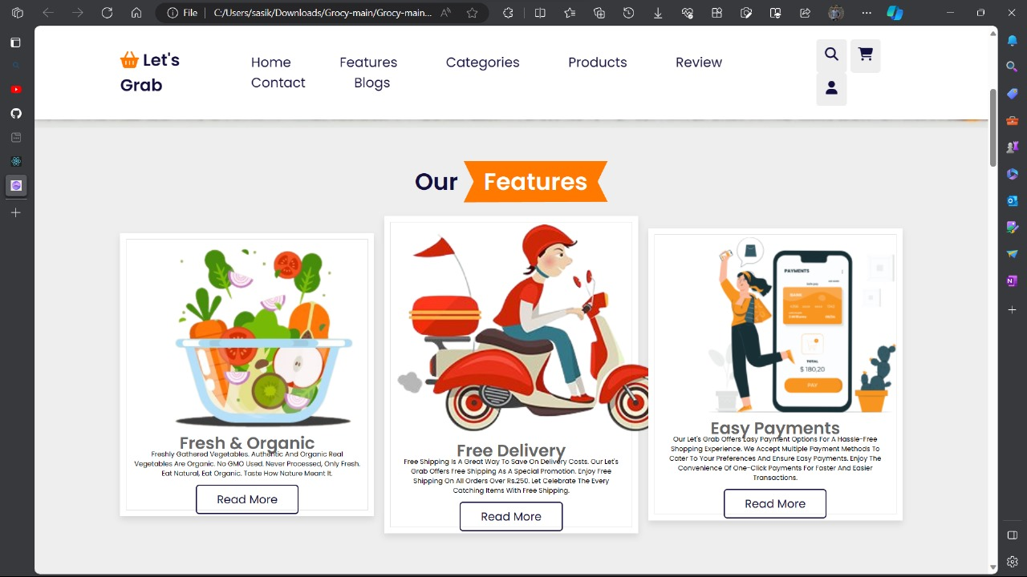
UI Interface

Slide 9
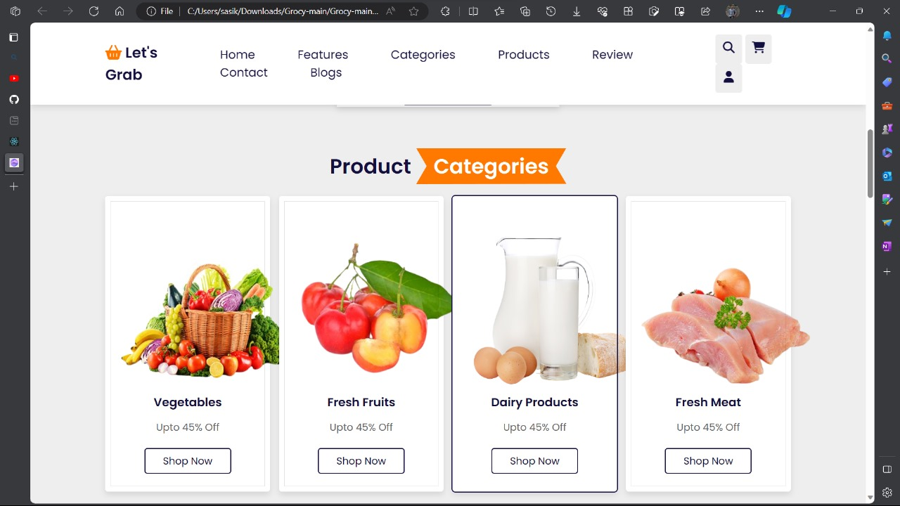
Product Details

Slide 10
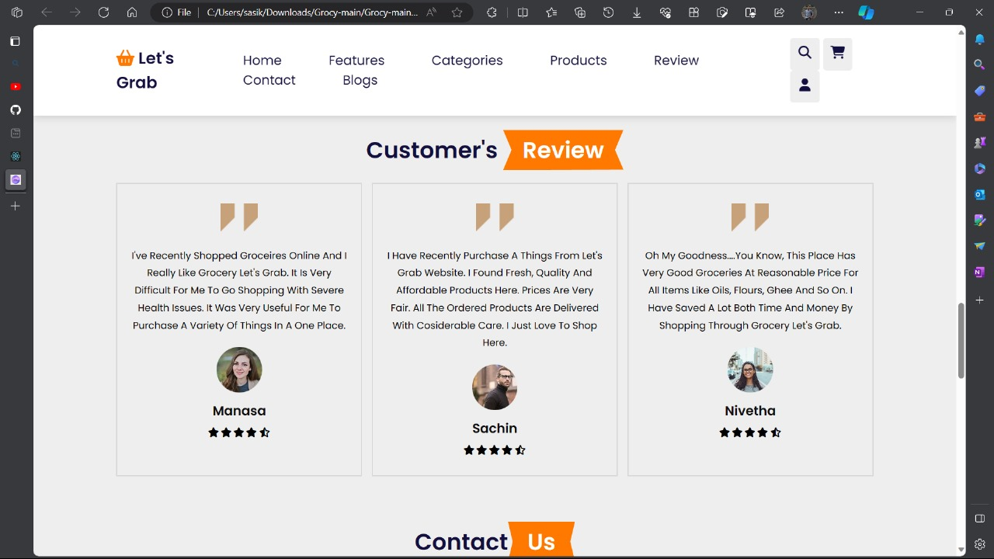
Customer Review

Slide 11
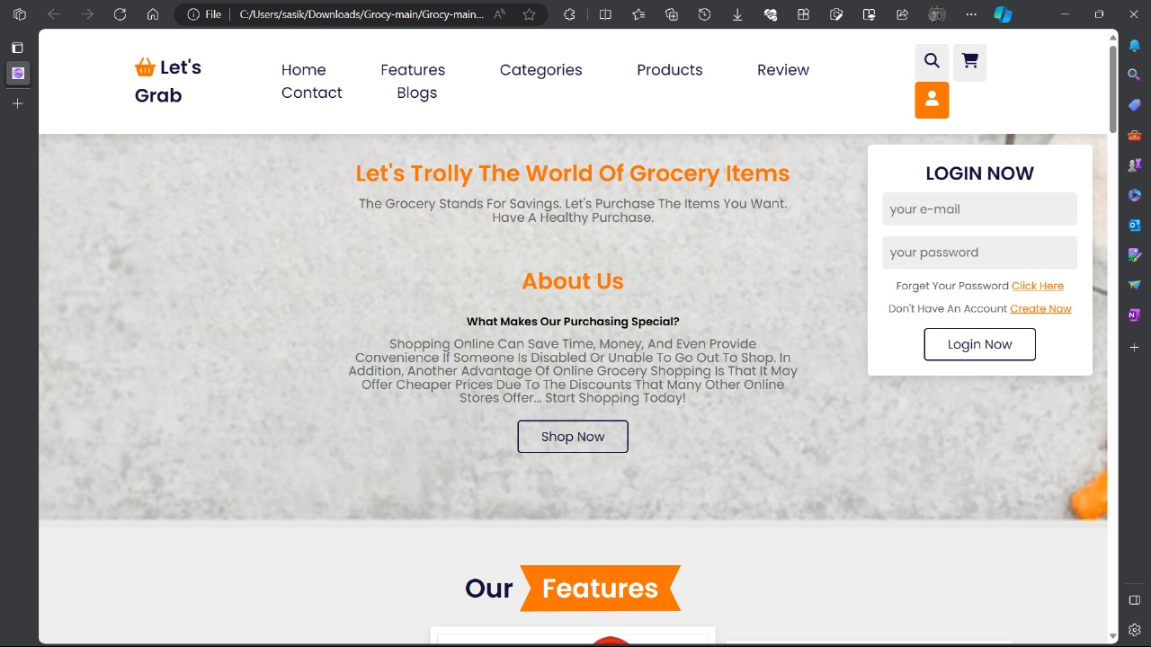
Login Page

Slide 12

AssessmentꢀParameter
SetupꢀProjectꢀforꢀCalculatorꢀ
project
Setupꢀbasicꢀstructureꢀofꢀtext-
editorꢀproject
Createꢀaꢀmainꢀcomponentꢀwithꢀtheꢀ
outerꢀstructureꢀofꢀcalculator
Check-List
Createꢀmainꢀcomponentꢀwithꢀ
allꢀfeatureꢀbuttons
Createꢀaꢀbuttonꢀcomponentꢀ
withꢀonꢀclickꢀhandler
Createꢀaꢀjsonꢀobjectꢀtoꢀstoreꢀ
dataꢀforꢀtextꢀeditor
Createꢀaꢀ`ꢀevaluateExpresion`ꢀ
functionꢀtoꢀevaluateꢀvalue
Pushꢀbothꢀcodeꢀtoꢀgithub

Slide 13
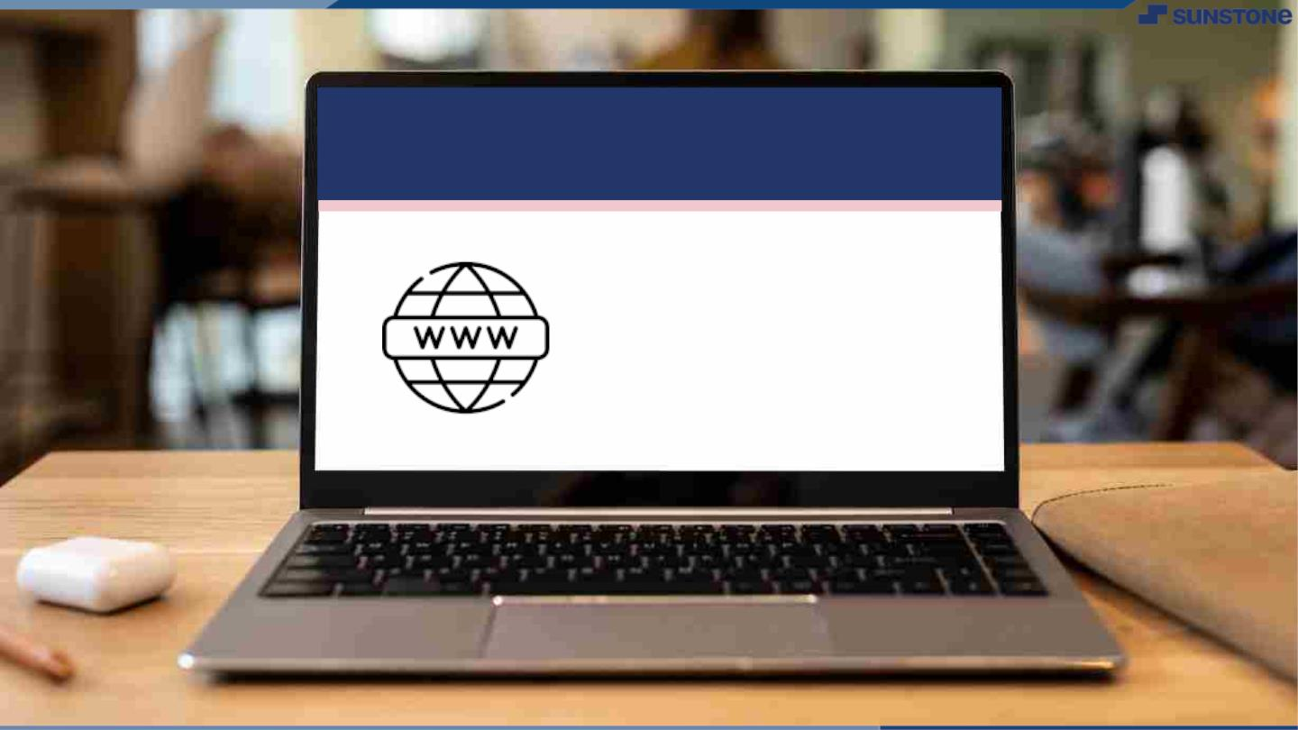
Submission Github
https://github.com/RathishJ/NM-batch10/tree/main/Assessment%2002

Slide 14


